Slide 1

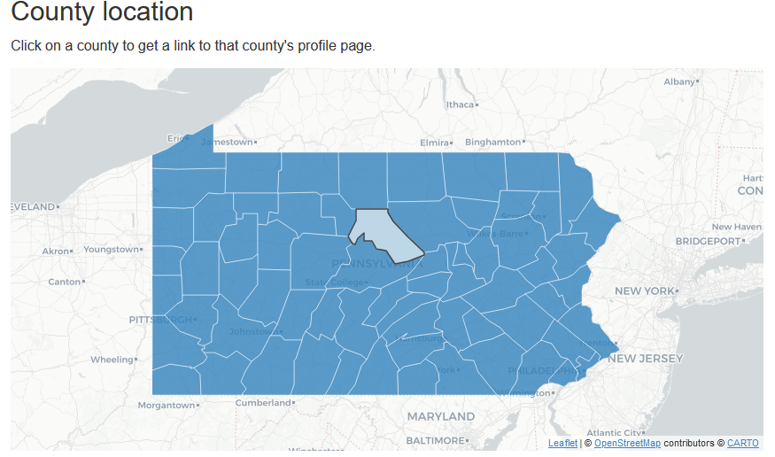
Introduction
[font settings] [zoom] [audio reader] [search bar] [download pdf] [share]
Introduction
Methods
Communities
[search bar]
Alsip
Arlington Heights
Barrington
Barrington Hills
Bartlett
Bedford Park
Bellwood
Bensenville
Berkeley
Community X
…
This report presents a wide variety of health health indicators for every community in suburban Cook County, Illinois. The report contains the measures for one community per page. You can go to a community’s page by clicking on the county name in the navigation box to the left or on a community in the map below.
The community health indicators are accompanied by both numbers and rates. The most up-to-date health data is compared against past health data to show changes or patterns. For more information, please see the methodology.

Slide 2
Larger Example of the Map

Slide 3
Methodologies
Introduction
Methods
Communities
[search bar]
Alsip
Arlington Heights
Barrington
Barrington Hills
Bartlett
Bedford Park
Bellwood
Bensenville
Berkeley
Berwyn
…
Data sources
All of the health data on the Cook County community profiles has been analyzed and interpreted by Cook County Department of Public Health Health from the following sources:
Cook County Health Atlas
[list data sources]
Data are updated whenever new data are provided by the original source. For data provided by federal government agencies, this is usually on an annual basis.
Site Disclaimer
This site provides summary data that may have been modified for use from its original source.
Note about ZIP Codes
U.S. Postal Service ZIP Codes are designed to meet the day-to-day operational needs of the U.S. Postal Service and tend to change frequently. To account for this instability, the USPS defines ZIP Code Tabulation Areas (ZCTAs) which mark the land generally covered by each ZIP code. For this reason, some ZIP codes may be available under a different ZCTA if they are very small or only used by P.O. Boxes.
Data Suppression and Reliability
Some counts and rates are suppressed (not shown) due to small counts or small population denominators which might make the rate unstable or affect privacy. Data are suppressed and thus unavailable when specific thresholds for minimum counts, minimum population-at-risk (denominator), or maximum relative standard error are not met. Protection of an individual’s confidentiality is of paramount importance to this effort and no attempt should be made to identify individuals or households within locations and/or zip codes. Specific guidelines used for flagging and suppressing data vary by indicator and can be found within the technical notes for each indicator.
Note about generative AI usage/ automation
Generative AI/ automation is used to write the summative strengths, challenges, and highlights of each community profile.
Notes:
This is ripped right off of the CCHA

Slide 4
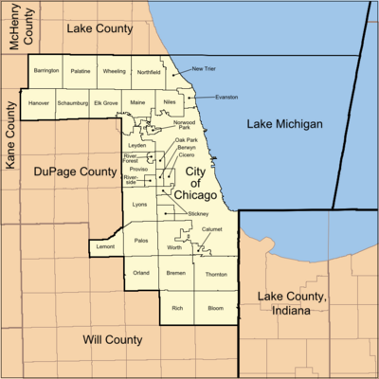
Community X Profile
[font settings] [zoom] [audio reader] [search bar] [download pdf] [share]
Introduction
Methods
Communities
[search bar]
Alsip
Arlington Heights
Barrington
Barrington Hills
Bartlett
Bedford Park
Bellwood
Bensenville
Berkeley
Berwyn
…
Strengths
Challenges
Highlights
Source
This page is the community profile for Community X. It contains health statistical measures for the community. The data is sourced from the Cook County Health Atlas. For more information, please see the methodology page.
Simplified View
View all tables
Community Location
Notes:
This is the landing page
Reference: PA LHD community profiles
The strengths and weaknesses box would actually be placed

Slide 5
Introduction
Methods
Communities
Community X
• Demographics
• Socioeconomics
• Health Outcomes
• Health Care
• Health Behaviors
• Physical Environment
Demographics
Who lives here?
Demographics refer to the statistical characteristics of a community, such as age, gender, race or ethnicity, and family structure. These factors can impact health outcomes by influencing access to resources, experiences of discrimination, and social support – all of which play a role in shaping a person’s overall health and well-being.
3-5 insights interpreting the raw data found in the data table below
Infographics
(charts, graphs,illustrations etc.)
Ideas:
Age distribution bar graph
Race & ethnicity composition pie chart
Man & Woman symbols accompanied by %
👨🏻 49% | 👩🏻 51%
Table of selected characteristics
(see spreadsheet)
Notes:
Hovering over each indicator with cursor provides the indicator’s definition
Racial & ethnic composition mirrors what is included in the CCHA

Slide 6
Introduction
Methods
Communities
Community X
• Demographics
• Socioeconomics
• Health Outcomes
• Health Care
• Health Behaviors
• Physical Environment
Socioeconomics (Updated Example 1/12/2025)
Socioeconomic status refers to a person's economic and social position. Factors such as race or ethnicity, income, education, and occupation influence a person’s socioeconomic status and affect access to resources such as healthcare, housing, and food, which in turn influence their overall health and well-being.
[explanatory section] ….
3-5 insights interpreting the raw data found in the data table below
Infographics
(charts, graphs,illustrations etc.)
Ideas:
Age distribution bar graph
Race & ethnicity composition pie chart
Man & Woman symbols accompanied by %
👨🏻 49% | 👩🏻 51%
Table of selected characteristics
(see spreadsheet)
Notes:
Hovering over each indicator with cursor provides the indicator’s definition
Racial & ethnic composition mirrors what is included in the CCHA

Slide 7

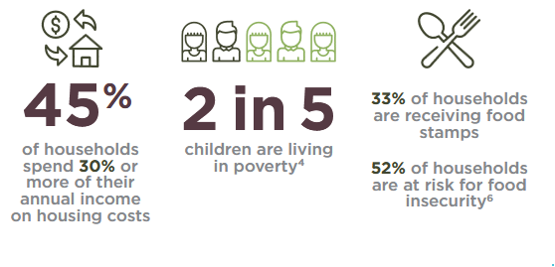
Introduction
Methods
Communities
Community X
• Demographics
• Socioeconomics
• Health Outcomes
• Health Care
• Health Behaviors
• Physical Environment
Socioeconomics (Updated Example 1/12/2025)
Socioeconomic status refers to a person's economic and social position. Factors such as race or ethnicity, income, education, and occupation influence a person’s socioeconomic status and affect access to resources such as healthcare, housing, and food, which in turn influence their overall health and well-being.
[explanatory section] The median household income of [Community X] was [$29,285] in [2022]. Approximately [29%] of the community is living in poverty, and [24%] is experiencing unemployment. The income inequality ratio comes out to [0.30]. Approximately [87%] of the community has obtained a high school degree or equivalent.
A large percentage of the Community X population is living in poverty. 29% of Community X residents live below the poverty line, with 40% of children in the area living in poverty. This high poverty rate likely contributes to other socioeconomic issues faced by residents.
High unemployment contributes to financial hardship in Community X. The unemployment rate in Community X is 21%, more than double the rate of Chicago.This lack of employment opportunities can make it difficult for residents to improve their economic standing.
Housing costs place a heavy burden on Community X residents. 33% of Community X households spend 30% or more of their annual income on housing costs. This high housing cost burden can further strain already limited finances.
Table of selected characteristics
(see spreadsheet)
Notes:
Fictional data is used

Slide 8
Introduction
Methods
Communities
Community X
•Demographics
•Socioeconomics
• Health Outcomes
• Health Care
• Health Behaviors
• Physical Environment
Health Outcomes
Health outcomes are the ways we measure the health and well-being of a community. They are influenced by factors like social conditions, access to medical care, and the health choices people make.
3-5 insights interpreting the raw data found in the data table below
Infographics
(charts, graphs,illustrations etc.)
Table of selected characteristics
(see spreadsheet)

Slide 9
Introduction
Methods
Communities
Community X
• Demographics
• Socioeconomics
• Health Outcomes
• Health Care
• Health Behaviors
• Physical Environment
Health Care
Community members’ access to quality health care.
Access to quality healthcare services plays a vital role in preventing and managing diseases while promoting health equity. However, high costs, insufficient insurance coverage, and limited availability of quality services often create significant barriers to clinical care.
3-5 insights interpreting the raw data found in the data table below
Infographics
(charts, graphs,illustrations etc.)
Table of selected characteristics
(see spreadsheet)

Slide 10
Introduction
Methods
Communities
Community X
• Demographics
• Socioeconomics
• Health Outcomes
• Health Care
• Health Behaviors
• Physical Environment
Health Behaviors
Health behaviors are individual actions we take to prevent illnesses and stay healthy, such as exercising and eating a balanced diet. These habits are greatly influenced by the social and economic conditions in which people live. For example, it’s hard to go outside for a walk to exercise if you don’t feel safe in your neighborhood.
3-5 insights interpreting the raw data found in the data table below
Infographics
(charts, graphs,illustrations etc.)
Table of selected characteristics
(see spreadsheet)

Slide 11
Introduction
Methods
Communities
Community X
• Demographics
• Socioeconomics
• Health Outcomes
• Health Care
• Health Behaviors
• Physical Environment
Neighborhood and Physical Environment
The neighborhood and physical environment refer to the natural and man-made surroundings in which people live, work, and play. This includes This includes factors like air and water quality, housing, and neighborhood safety.
3-5 insights interpreting the raw data found in the data table below
Infographics
(charts, graphs,illustrations etc.)
Table of selected characteristics
(see spreadsheet)

Slide 12
Simplified View
Single table of all health indicators without any narrative text or figures.

Slide 13
Presentation Notes
Use AI-generated infographics to summarize the content of each data table per topic area (e.g., demographics, socioeconomics, health outcomes)
Ai-generate three bullet pointed “insights” using the data table as an input
Insights align with the infographics
Insights and infographics appear side-by-side on the website

